Slide 1

ReCO:
A Large Scale Chinese
Reading Comprehension Dataset on Opinion
BingningWang, Ting Yao, Qi Zhang,
Jingfang Xu, Xiaochuan Wang
Sogou
Notes:
Hello everyone I’m Binging Wang from Sogou, its my spotlight poster presentation of our work about ReCO, a large scale Chinese reading comprehension dataset on opinion.

Slide 2
Machine reading comprehension dataset time flow
SearchQA
TrivaQA
NarrativeQA
CLOZE
RACE
SCT
ARC
Dream
DuReader
SQuAD2.0
NaturalQuestions
…
SQuAD
MSMARCO
NewsQA
LAMBDA
Who did what
bAbi
CNN/DailyMail
ChildrenBookTest
MCTest
bioProcess
2013
2014
2015
2016
2017
2018
Notes:
Previous works on machine reading comprehension are essentially based on the development of reading comprehension datasets. From the very first introduction of MCTest, several dataset have been proposed, such as babi,Squad, and microsoft marco, baidu dureader et.al.

Slide 3
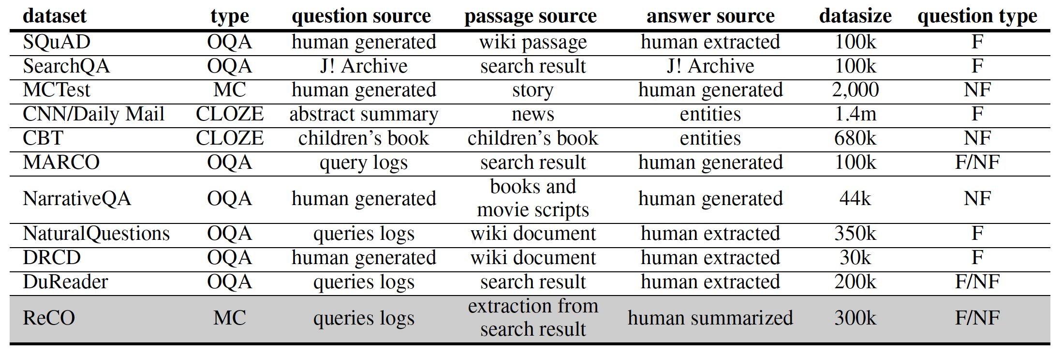
Characteristics of current MRC dataset
OQA: span extraction
MC: multiple choice
F: Factoid
NF: Non-factoid

Slide 4
Limitations of previous MRC dataset:
The MRC context in most previous datasets are limit to the relatively long document or paragraph, which contains much irrelevant information to the question
Most previous MRC datasets are focus on factoid questions such as who, when, where, etc.
Notes:
However, there are many limitations of the previous machine reading comprehension dataset, first of all, in previous dataset the context, such as the paragraph or document, contains very much irrelevant information to the question, which sometimes limit the MRC to the information retrieval process. Secondly, most previous works are heavily built upon facoid questions, where the context dereived from the Wikipedia.

Slide 5
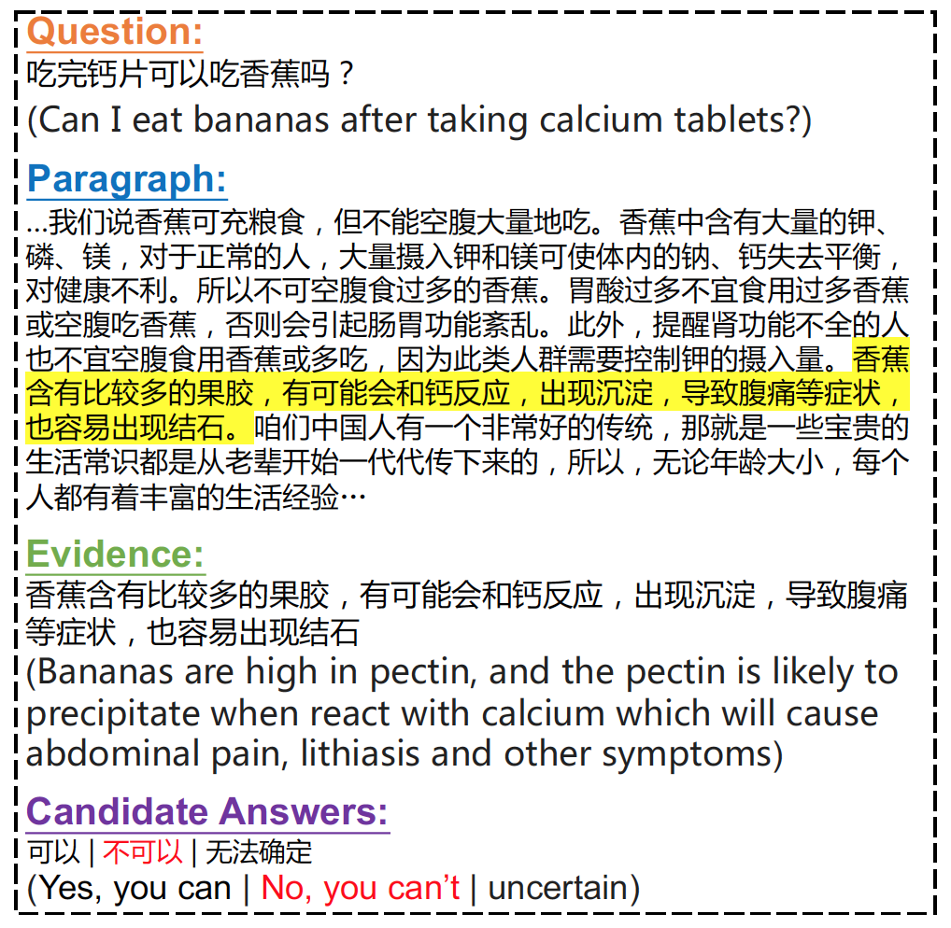
ReCO: A Large Scale Chinese Reading Comprehension Dataset on Opinion
Opinion based (factoid/non factoid)
Large scale (300k)
Document+Evidence
Notes:
In this paper, we present reco, A Large Scale Chinese Reading Comprehension Dataset on Opinion. ReCO is opinion based MRC datasets which contains both factoid and non-factoid questions, and the dataset is purely human annotated which contains both nearly 300 thousands questions. And what makes ReCO most different from previous mrc dataset is that in addition to the context document, we also ask the annotater to extract the supporting evidence for each question.

Slide 6
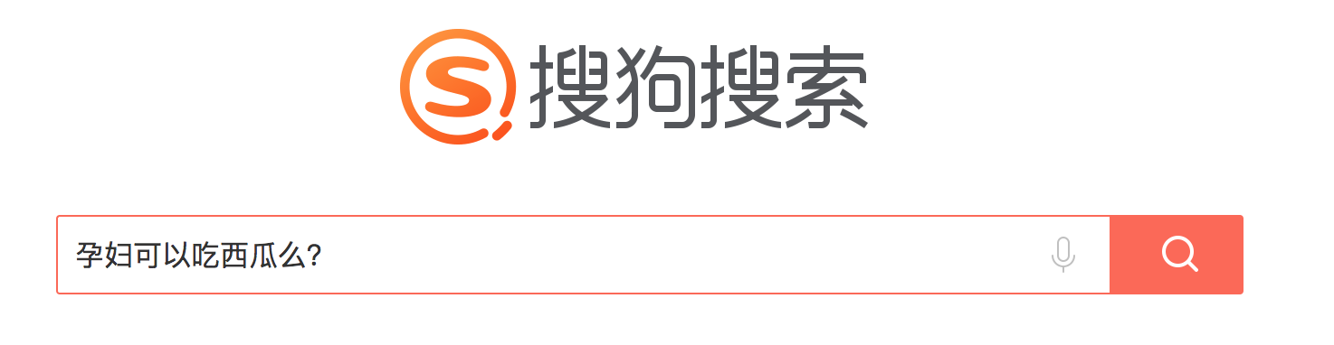
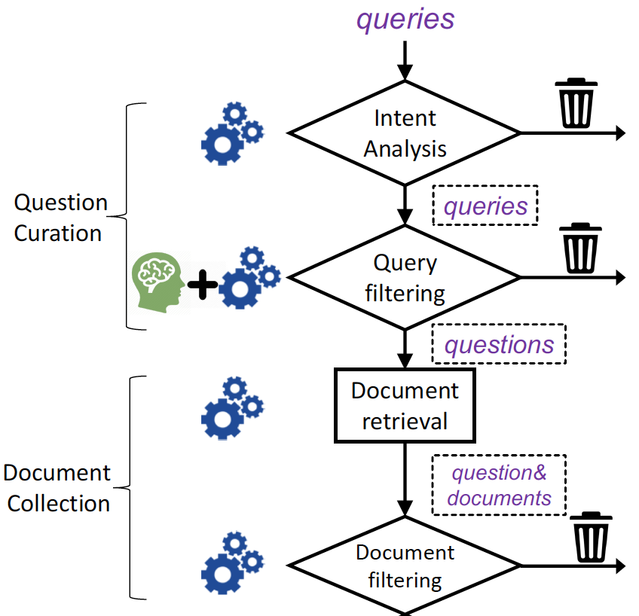
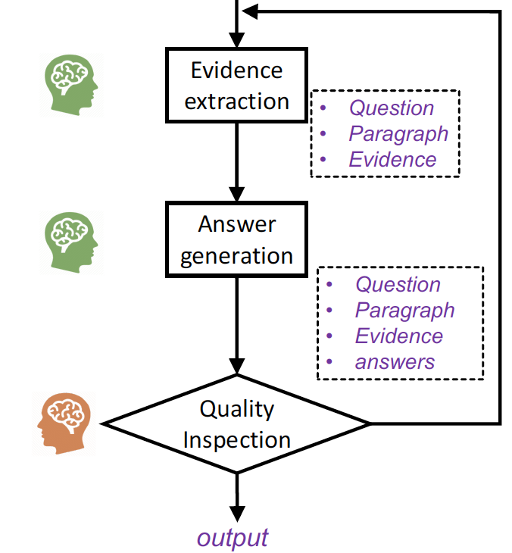
Data Collection
Notes:
This is the workflow of our data collection process, the questions are real-world queries issued to Sogou search engine.

Slide 7
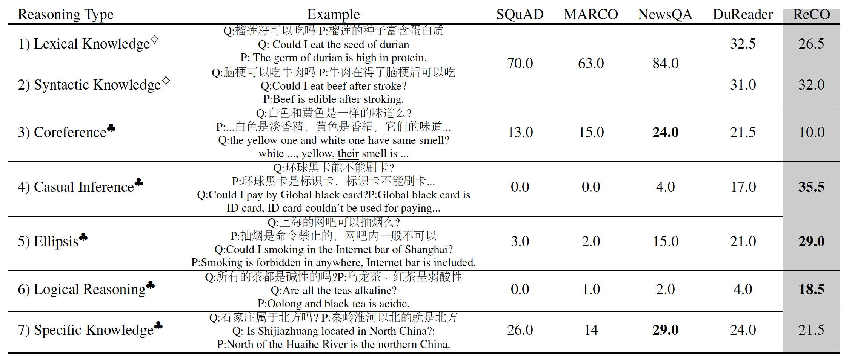
Characteristics of ReCO
Notes:
And we can see that compared to other datasets ReCO contains more hard problems that requires deeper reasoning.

Slide 8
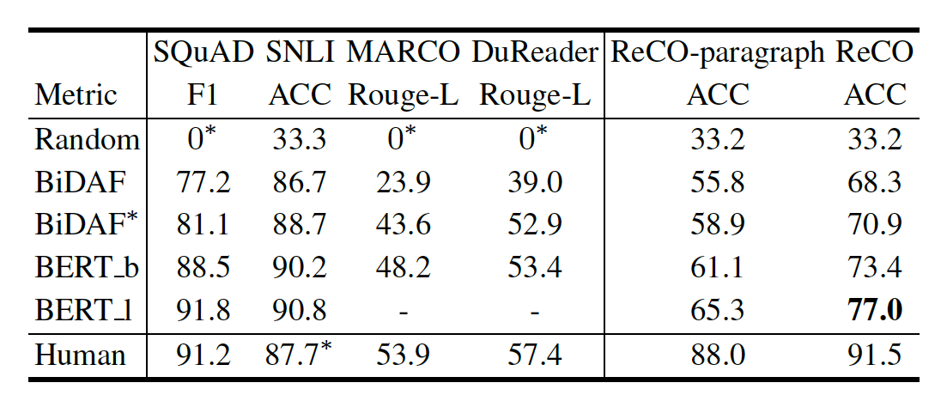
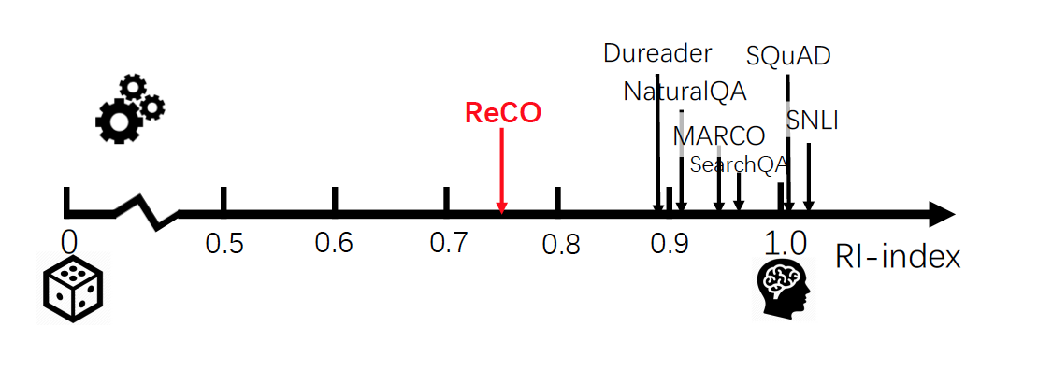
Model performance on ReCO
Notes:
Experimental results shows that current sota models strives to have good performance on RECO.

Slide 9
Everything could be found at:
https://github.com/benywon/ReCO
Notes:
Codes and dataset could be found at this url.Thank you

